Slide 1
COVID-19 Vaccinations Trend Analysis

Slide 2
AIM:
To analyze the COVID-19 vaccinations trend analysis is to comprehensively examine and understand the patterns, progress, and impact of COVID-19 vaccination efforts over a specified time period.
This analysis seeks to provide valuable insights into the distribution, coverage, and effectiveness of COVID-19 vaccination campaigns to inform public health strategies, resource allocation, and policy decisions.

Slide 3
Introduction:
The global response to the COVID-19 pandemic has been marked by unprecedented efforts to develop and distribute vaccines to curb the spread of the virus and mitigate its impact on public health.
As nations worldwide continue to administer COVID-19 vaccines, understanding the trends, patterns, and outcomes of these vaccination campaigns becomes crucial for informed decision-making and effective resource allocation.
This analysis aims to provide a comprehensive examination of the trends in COVID-19 vaccinations, shedding light on critical aspects of vaccine distribution, coverage, and impact.

Slide 4
Problem statement:
Vaccination Disparities: The uneven distribution of vaccines among different regions and demographic groups raises concerns about equitable access. This analysis seeks to identify disparities in vaccine coverage, focusing on vulnerable populations and underserved areas.
Trend Dynamics: Understanding the dynamic shifts in vaccination rates over time is essential for informed decision-making. This analysis aims to identify trends, accelerations, and decelerations in vaccination efforts and their potential drivers.
Impact Assessment: Determining the impact of vaccination campaigns on COVID-19 outcomes, such as case rates, hospitalizations, and mortality, is a critical challenge. This analysis aims to evaluate the correlation between vaccination rates and disease outcomes.
Vaccine Preference: Exploring the distribution of different vaccine types administered across regions or countries and their implications for overall vaccination rates is another challenge. This problem area aims to uncover vaccine preferences and their effects on the vaccination landscape.
Predictive Insights: Anticipating future vaccination rates and projecting the achievement of vaccination milestones requires predictive modeling. This problem area seeks to develop models that forecast vaccination trends based on historical data.

Slide 5
Methodology:
Exploratory Data Analysis (EDA): Conduct exploratory analysis to gain initial insights into the data. Create visualizations, such as line charts, bar graphs, and heat maps, to visualize trends and patterns in vaccination rates over time, across regions, and among demographic groups.
Demographic and Geographic Disparities Analysis: Segment the data by demographics (age, gender, ethnicity) and geography (country, region, urban/rural). Analyze vaccination rates across different demographic groups and geographical areas to identify disparities and inequalities in vaccine coverage.
Vaccine Type Distribution Analysis: Examine the distribution of different COVID-19 vaccine types administered. Compare vaccination rates associated with different vaccines and explore any variations in preferences across regions or countries.

Slide 6
Analysis:
Line Chart: Power BI will automatically aggregate the using sum on the people_fully_vaccanies on the years, creating a stacked column chart that shows the distribution of active users by country and region.
Clustered Column Chart: Create a new page in your report dedicated to the clustered column chart, Place a clustered column chart on the page.
Set the X-axis to represent time (date or week) and the Y-axis to represent the number of vaccinations.
Line and Clustered Column Chart: Power BI will automatically aggregate the using sum on the total vaccination on the years in vaccines, creating a stacked column chart that shows the distribution of active users by country and region.

Slide 7
Multi- row card: Develop a data model and establish relationships between relevant tables if necessary, Create a new page in your report dedicated to showcasing key metrics using multi-row cards. Add multiple multi-row cards to the page, each representing a different key metric, Include slicers for users to filter data by specific time frames (days, weeks, months) or demographic variables. Ensure that the multi-row cards respond to slicer selections, providing contextualized information.
Area chart and Slicing and card: Add an area chart to the page, Place date or time on the X-axis and the number of vaccinations on the Y-axis , Use the area chart to visualize the trend of daily or cumulative vaccinations over time, Add slicers to the page to enable users to filter data by specific time frames (days, weeks, months),The selected time frame should dynamically update the area chart.

Slide 8
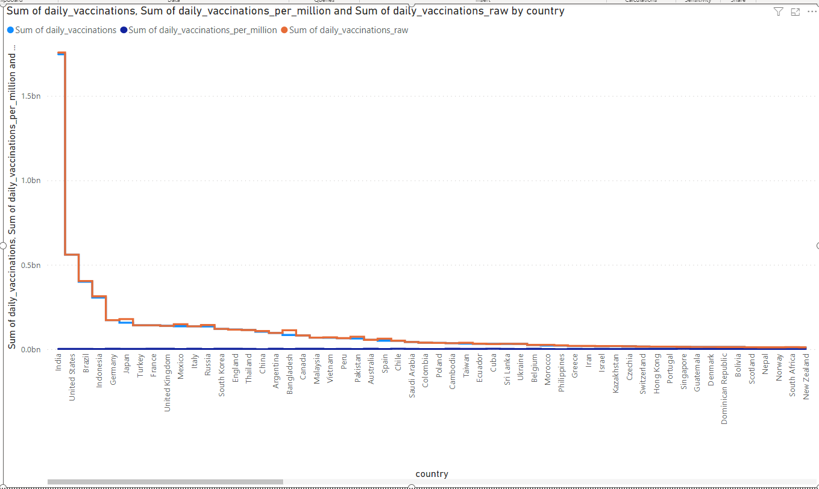
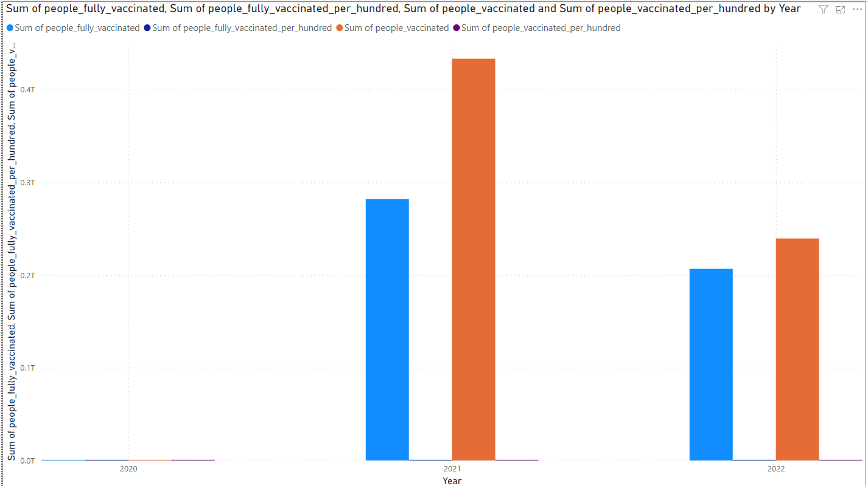
Insights:
Line Chart: Create a new page in your report dedicated to the line chart, Place a line chart on the page. Set the Y-axis to "Country" and the X-axis to "Date." Drag the "Daily Vaccinations" field into the "Values" section of the visual. Power BI will automatically sum the daily vaccination counts for each country.
Add a second line to the chart for daily vaccinations per million. Create a calculated column for "Daily Vaccinations Per Million" by dividing "Daily Vaccinations" by 1,000,000.Drag the "Daily Vaccinations Per Million" field into the "Values" section. Power BI will automatically sum the calculated values for each country.
Clustered Column Chart: you're using the vaccination metrics like "people_vaccinated," "people_fully_vaccinated," "people_vaccinated_per_hundred," and "people_fully_vaccinated_per_hundred" on the y-axis and the year on the x-axis in a clustered column chart with the automatic sum function, here's how you can create the Clustered Column Chart in Power BI for your COVID-19 Vaccinations Trend Analysis .
Place a clustered column chart on the page. Set the X-axis to "Year" and the Y-axis to the vaccination metrics (e.g., "people_vaccinated," "people_fully_vaccinated," etc.).
Power BI will automatically sum the values for each year.

Slide 9
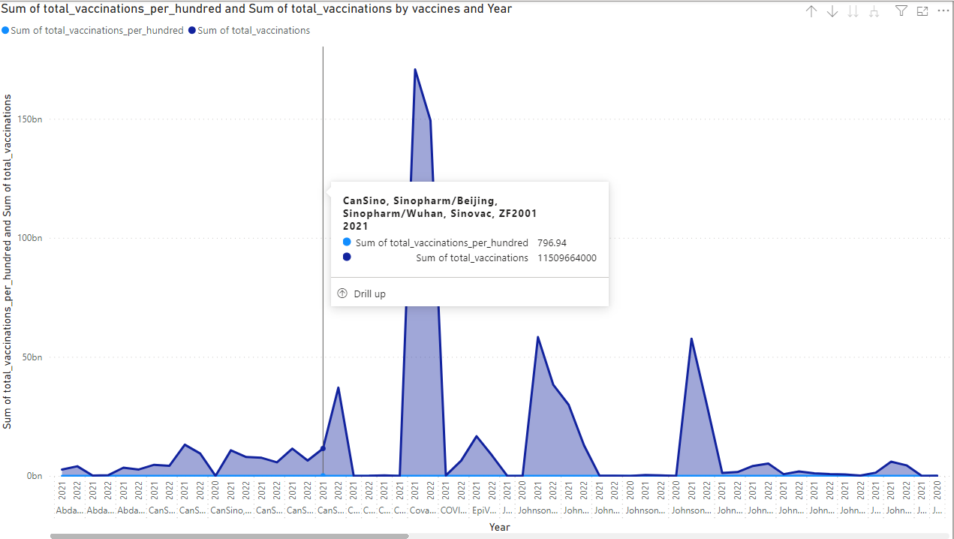
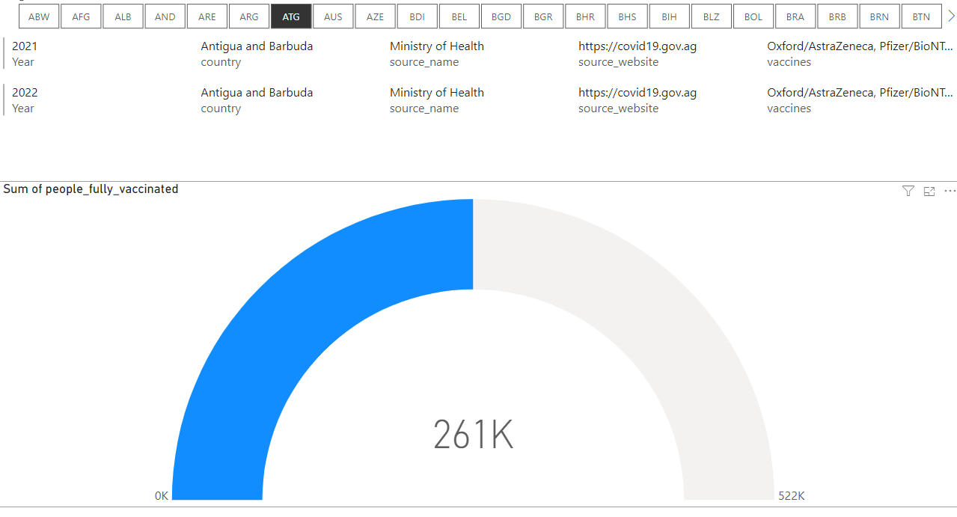
Area Chart: Create a new page in your report dedicated to the line chart, Place a Area chart on the page. Set the Y-axis to “year" and “vaccines“, Drag the “Total Vaccinations" field into the "Values" section of the visual. Power BI will automatically sum the Total vaccination counts for each year.
Add a second line to the chart for daily vaccinations per million. Create a calculated column for " Total Vaccinations Per hundred" field into the "Values" section. Power BI will automatically sum the calculated values for each year.
slicing : There are using iso_code to use a slicing part on the title method used for slicing settings,
multi-row card: There are using a year, country source Name, source website, Vaccines will be used for multi-row card for the power bi.
Gauge: There are using a gauge function on the people fully vaccinated in the power bi.
There are using all method of automatically used for sum function on the gauge.

Slide 10
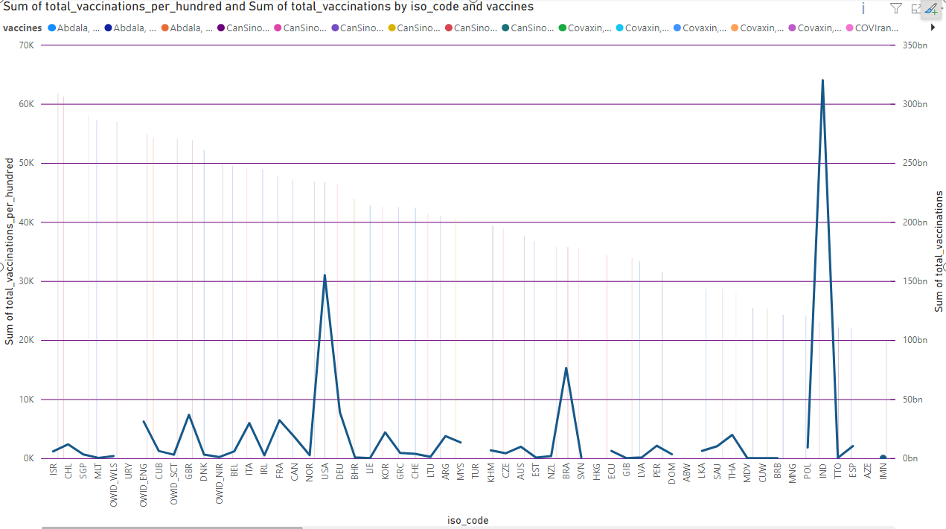
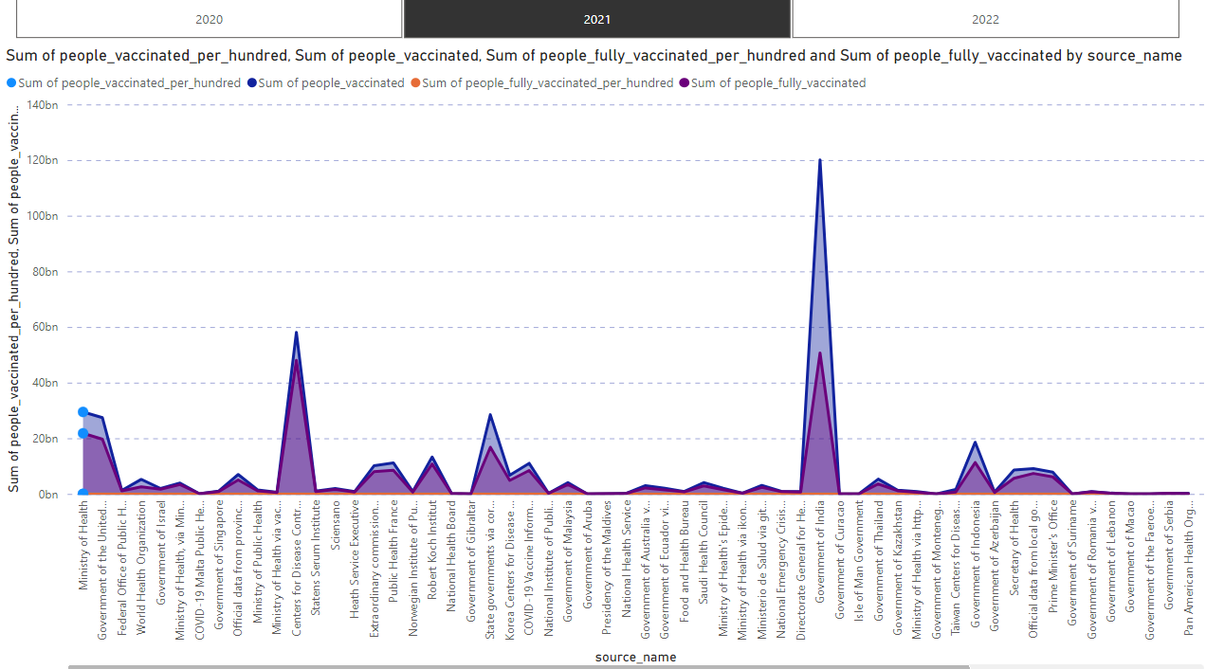
line and clustered column chart: There are using iso_code on the x-axis in the methods or doing part on the analysis a data for he total_vaccinations_per_hundred is automatelly selected a sum function on the on part and using a design for dotted method for the round of the functions.
There are using the Total Vaccinations on the using right side in the worked on the part of members will be used on the this method function to used line part on the settings
Area chart : There are using source name on the y-axis function on the Area chart.
And there are used in the four functions in the people_fully_vaccinated, people_fully_vaccinated_per_hundred, people_vaccinated, people_vaccinated_per_hundred. This is automatelly used on sum functions in Area Chart.
Slicing: There are used in year function in the slicing method to used on the Year.

Slide 11
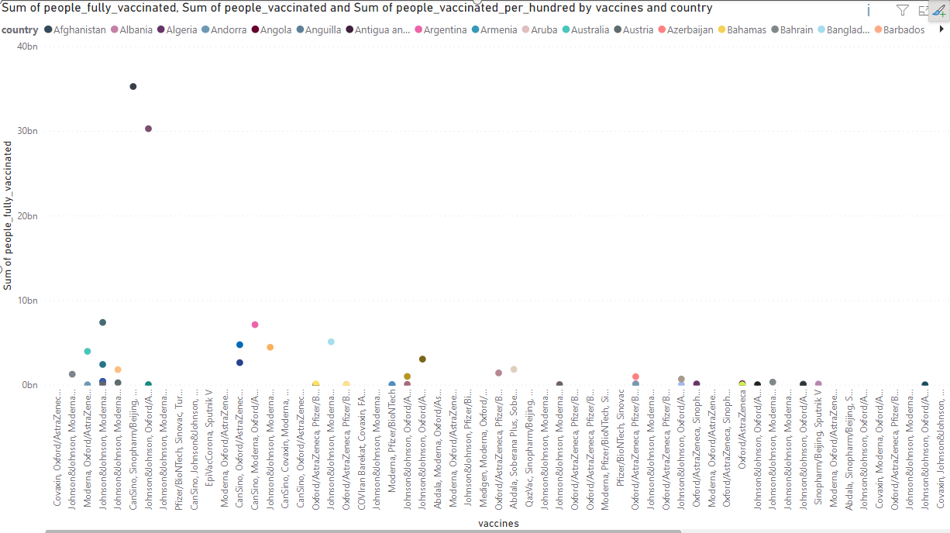
Recommendations:
Line Chart: There are using line chart method in the power bi, The method function will be used a people fully vaccinated, people vaccinated, people vaccinated per hundred its all is automate that are used to sum method.
There are using the y – axis functions is used a vaccines
And, There are using country for KPI’s formatted or LEGEND formatted there will be get automatelly get it that function on power Bi.

Slide 12
Conclusions:
Overall Vaccination Trend: The analysis of COVID-19 vaccinations reveals a significant and dynamic trend over the observed period. The vaccinations started slowly and gradually gained momentum, with a steep increase observed during certain months.
Vaccine Type Distribution: The distribution of vaccine types used across different countries has been diverse. Some regions predominantly adopted one vaccine type, while others opted for a combination of vaccines. This highlights the flexibility and adaptability of vaccination strategies.
Vaccination Disparities: Despite the progress made, the analysis also highlights disparities in vaccination rates among countries. Certain regions faced challenges in accessing vaccines, leading to uneven rates of immunization. These disparities emphasize the need for equitable vaccine distribution.

